Slide 1
Applied Statistics II Exercise 8
Harshkumar Vasoya, Aurélie Pahud de Mortanges, Loraine Schwander
Monday, 16.03.2020

Slide 2
A researcher studied the flexibility of women after taking different sports courses. The flexibility was measured by the spinal extension, a measure of how far the women could bend their backs. The ANOVA table of the data set looks as follows: Analysis of Variance Table:
Response: SpineExtension
 | Df | Sum Sq | Mean Sq | F value | Pr(>F)
Activity | 2 | 7.0352 | 3.5178 | 6.0667 | 0.006882**
Residuals | 26 | 15.0764 | 0.5799
Signif. codes: 0 `***' 0.001 `**' 0.01 `*' 0.05 `.' 0.1 ` ' 1

Slide 3
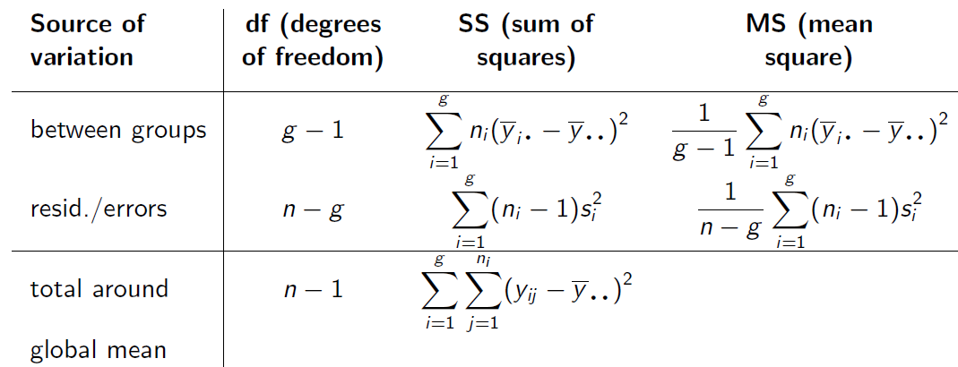
“g” is the number of groups and hence the number of parameters to fit in the model.
ANOVA table summarizes sources of variance

Slide 4
From the table
Answers
A
Degrees of freedom (df) is g-1 = 2, g = 3 which means that the number of groups participated is 3.
As n – g = 26, and g = 3, n = 29. Number of women participated: 29.
C: pooled standard deviation, s_{pool}

Slide 5
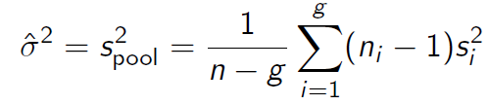
B
If our null hypothesis is that all sport courses lead to equal flexibility, at 5% level of null hypothesis, we can reject the null hypothesis as p value (0.006882) < 0.05. Therefore not all sport courses lead to the same flexibility. But we do not know which sport course is better or worse.
C: pooled standard deviation, s_{pool}
Where n = number of observations,
g = number of groups
s_{i}² = variance in the different groups:

Slide 6
“g” is the number of groups and hence the number of parameters to fit in the model.
ANOVA table summarizes sources of variance:
s²_{pool}

Slide 7
Exercise 8 A researcher studied the flexibility of women after taking different sports courses. The flexibility was measured by the spinal extension, a measure of how far the women could bend her back. The ANOVA table of the data set looks as follows: Analysis of Variance Table:
Response: SpineExtension
 | Df | Sum Sq | Mean Sq | F value | Pr (>F)
Activity | 2 | 7.0352 | 3.5178 | 6.0667 | 0.006882 **
Residuals | 26 | 15.0764 | 0.5799
Signif. codes: 0 `***' 0.001 `**' 0.01 `*' 0.05 `.' 0.1 ` ' 1

Slide 8
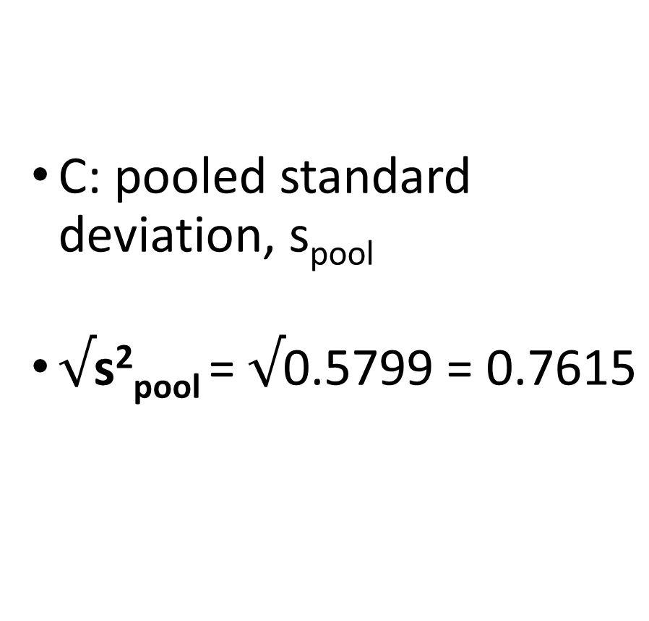
C: pooled standard deviation, s_{pool}
$\text{√}\text{s}\text{2}\text{pool} \text{= }√\text{0.5799 = 0.7615}$

Slide 9
Questions???

Slide 10


